Slide 1


Slide 2
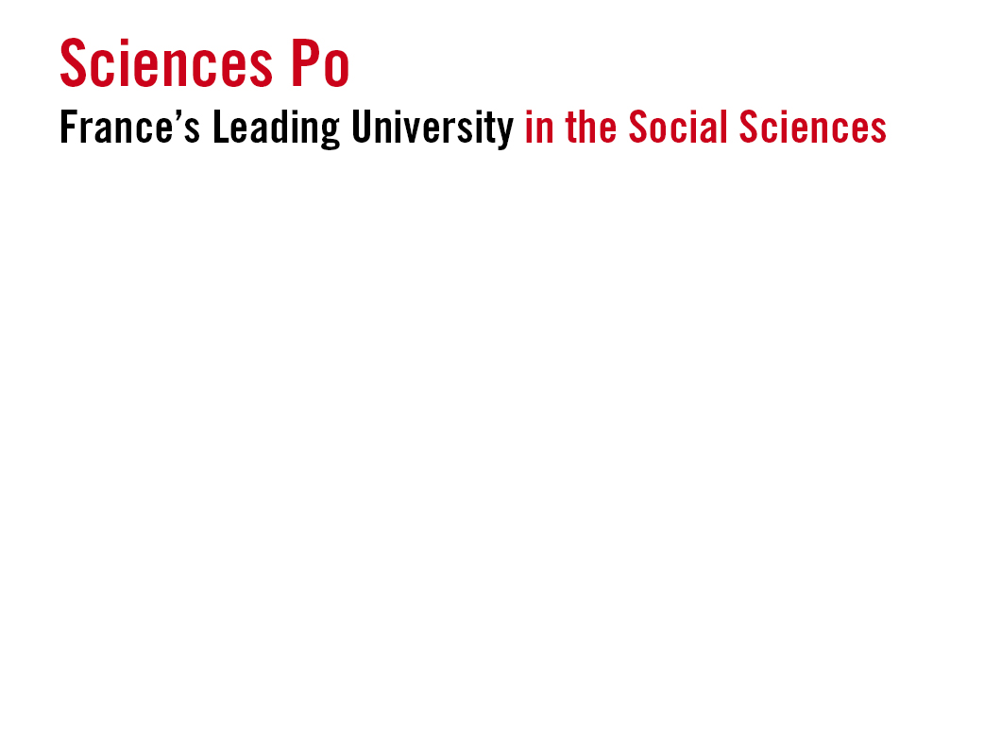
10 Research Units
80 visiting professors each year from all
over the world
5,000 lecturers with backgrounds in academia, business or public administration
13,000 students
46% international student body
coming from 150 countries
30% receive scholarships
55,000 Alumni Network
35% of Sciences Po’s budget is dedicated to research
1st French institution in QS World University Rankings in Political Science & International Relations and Sociology
410 partner universities
34 dual degree programmes
25 foreign languages taught

Slide 3


3 Year undergraduate degree
2 years in France & 1 year abroad
8 World Region Focuses
21-24 Hours of coursework per week
Art Workshops to Discover the Art of Politics
Group Projects
Opportunities for Student Engagement
Internships
25 Languages taught
English and French are languages
of instructions
Opportunity to learn Korean, Hungarian,
Chinese, Hindi, Russian, Portuguese, etc.

Slide 4

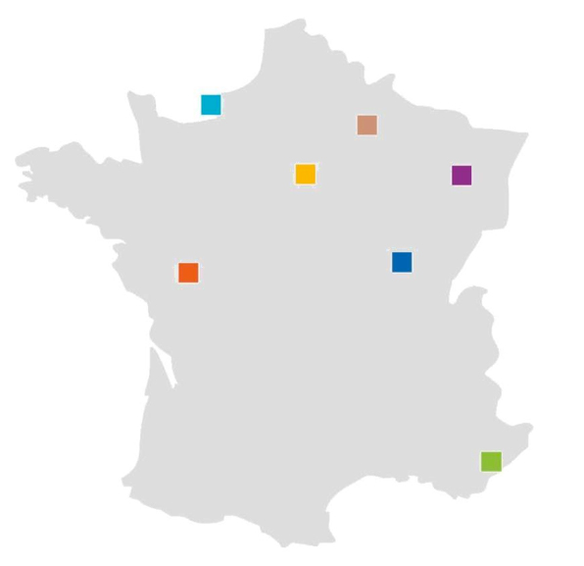
Le Havre Campus
Europe-Asia Relations*
Reims Campus
Europe-Africa Relations
Europe-North America
Relations*
Paris Campus
Graduate Study Programmes
Dijon Campus
Central and Eastern European Relations
Poitiers Campus
Europe-Latin America
Relations
Nancy Campus
European Franco-German Relations
Menton Campus
Europe Middle East Relations*
* Programmes taught in English with intensive French language study

Slide 5
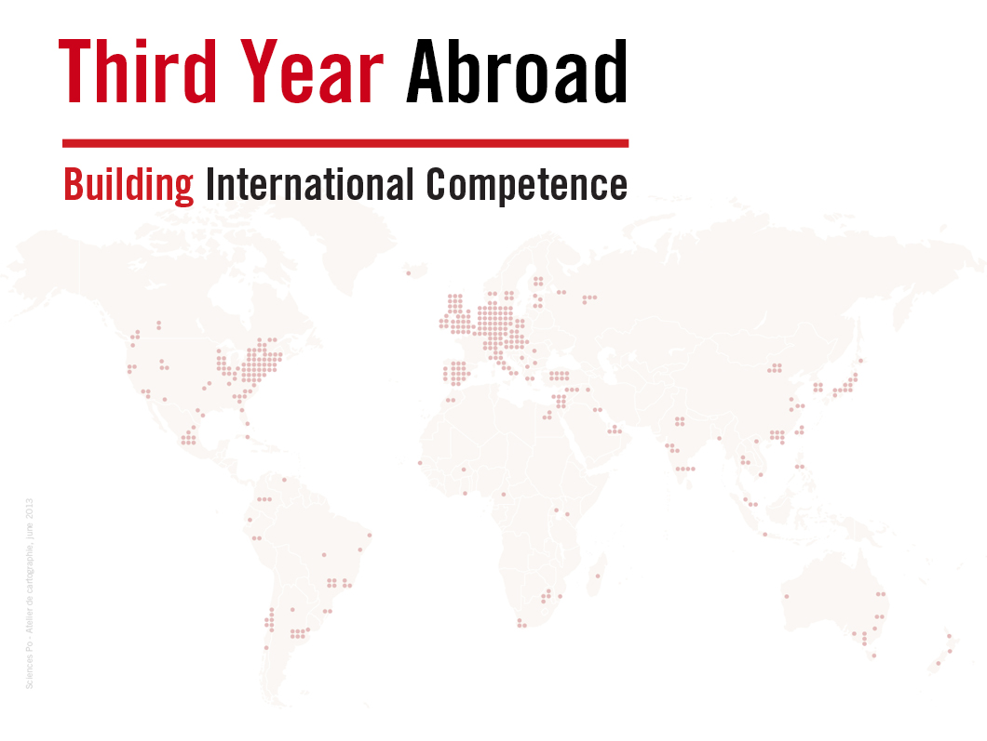
2 Semesters beyond Sciences Po and France
Academic Exchange in one of 410 Partner Universities
Internship
Personal Project
Objectives
Complement education and knowledge of studied world regions
Master language studied during the first two years at Sciences Po
Discover new activities and new academic pursuits

Slide 6
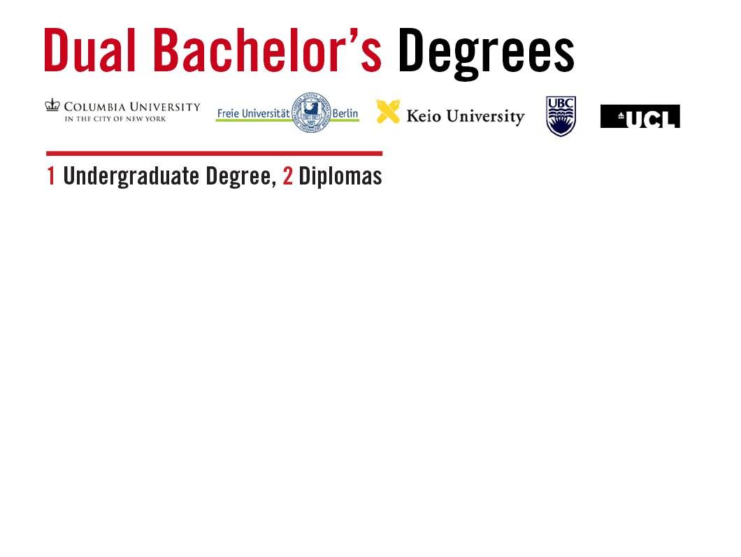
Columbia University - New York City
2 years at Sciences Po (Reims, Menton or Le Havre Campus)
Choice of 80+ majors & concentrations within the College of General Studies
Freie Universität Berlin
2 years at Sciences Po (Nancy Campus)
Major in political and social sciences at Freie Universität Berlin (English, French and German required)
Keio University – Tokyo
2 years at Sciences Po (Le Havre Campus)
Major in economics and Japanese language and culture at Keio
University of British Columbia – Vancouver
2 years at Sciences Po (Reims, Menton or Le Havre Campus)
Majors in business, economics, history, political science or sociology at UBC
University College London
2 years at Sciences Po (Dijon, Nancy, Poitiers, Paris or Menton Campus)
Majors in economics, history, international relations, law, philosophy or politics at UCL

Slide 7
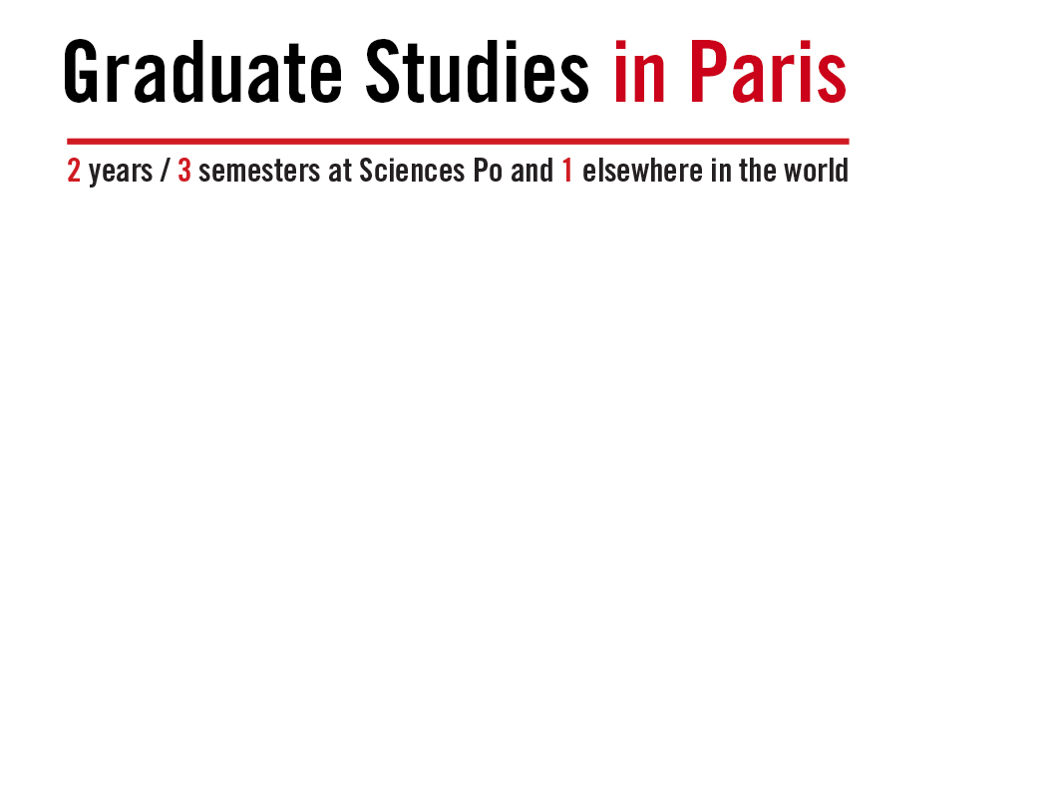
5 Graduate Schools - 30+ Master Programmes in French & English
Sciences Po Paris School of International Affairs
Sciences Po School of Communication
Sciences Po Law School
Sciences Po School of Journalism
Sciences Po Doctoral School
Urban Studies
Public Affairs
Economic & Corporate Affairs
Dual Master’s Degrees with 16 partner universities
3 Dual PhDs with Columbia, Northwestern and the Max Planck Institute

Slide 8

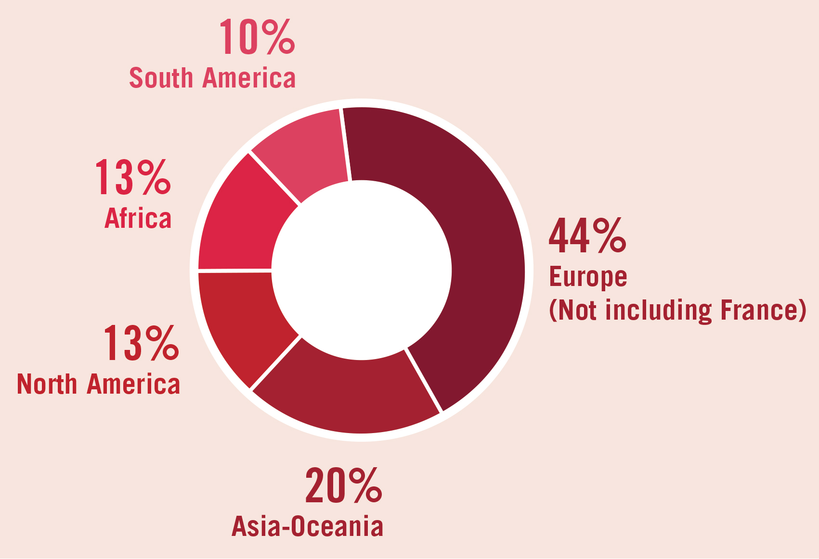
39% are recruited prior to graduation
80% find a job within 6 months following graduation
Common professions include:
Consulting
Marketing and Communication
Financial Services
International Relations and Security
39% Graduates start careers outside France
Sciences Po graduates
in the international job market

Slide 9


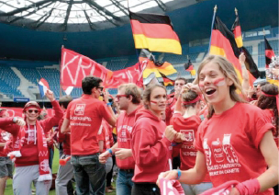
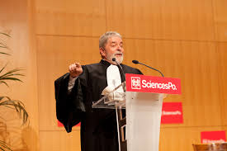
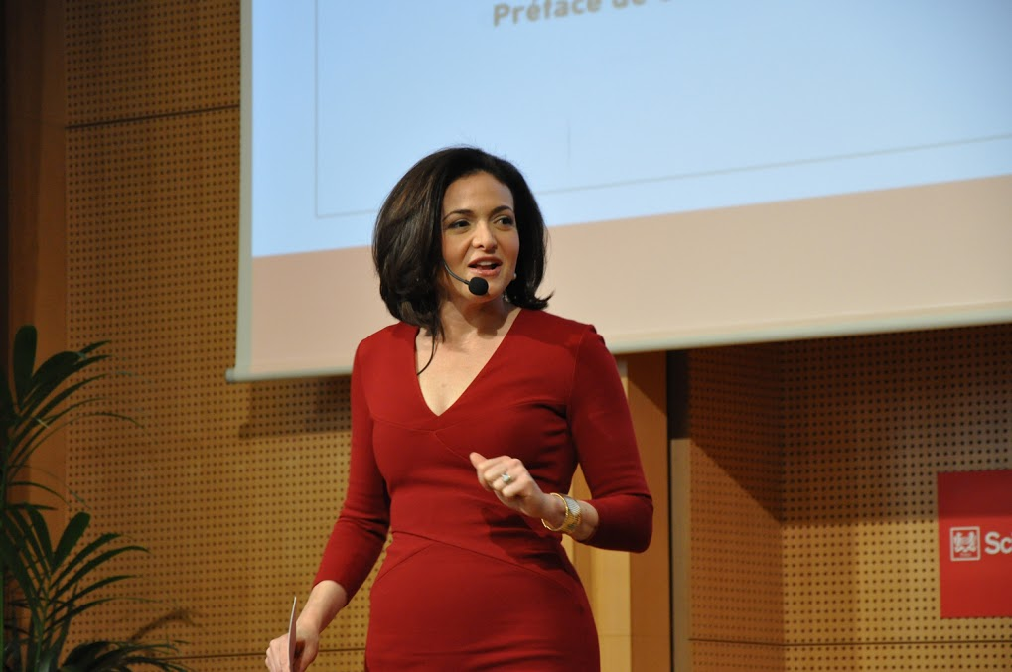

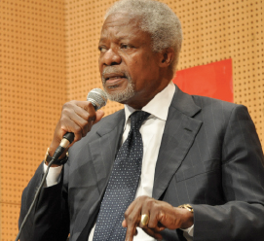
140 Student associations: politics, philanthropy, arts and sports
40 Sports available
Events with Kofi Annan, Luiz Inacio Lula da Silva, Condoleeza Rice, Joseph Stiglitz, Mario Draghi and Sheryl Sandberg, amongst others

Slide 10
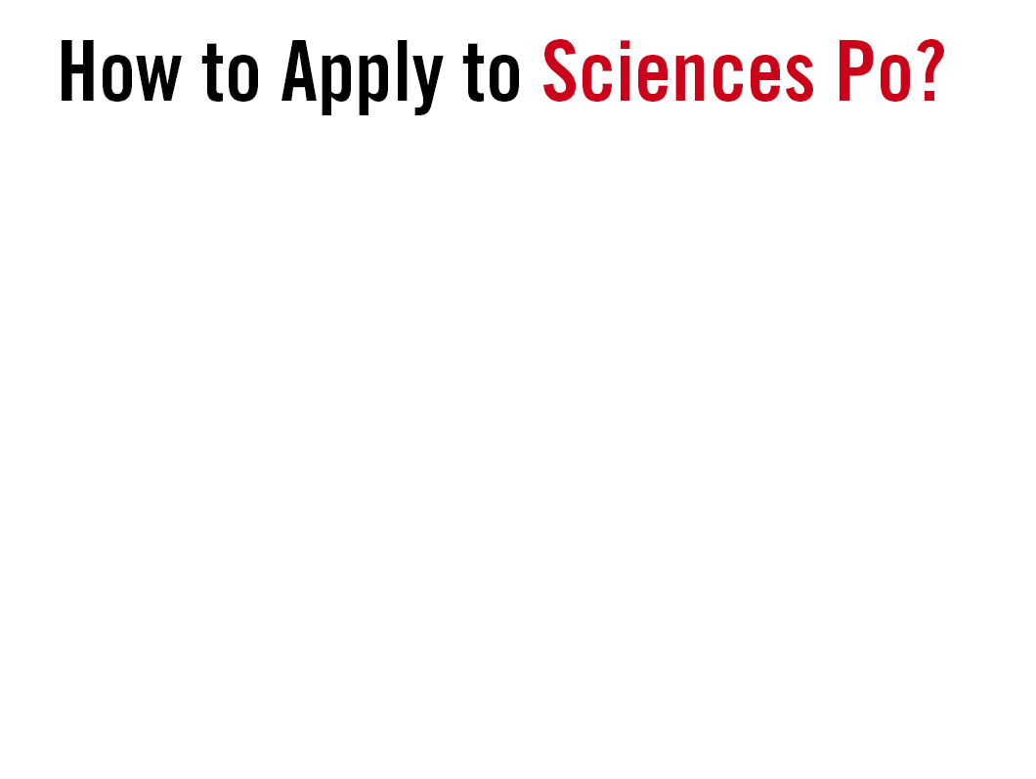

Steps for International
Undergraduate & Graduate Applicants
1 - Create your account - sciencespo.fr/admissions
2 - Choose the programme you wish to apply for
3 - Submit your application and supporting materials - reference letters, transcripts, personal statement
4 - Review by Admissions Committee
Short Listed Undergraduate Applicants
Graduate Applicants
5 - Prepare for the Sciences Po Interview
Prep of a 2-page press article (30 min)
Applicant presentation (10 min)
Q & A (20 min)
Ideal applicants demonstrate -
Knowledge of contemporary issues
Effective presentation techniques
Capacity to articulate opinions
6 - Admissions decision within one month of interview
5 - Admissions decision based on application file within two months of application

Slide 11
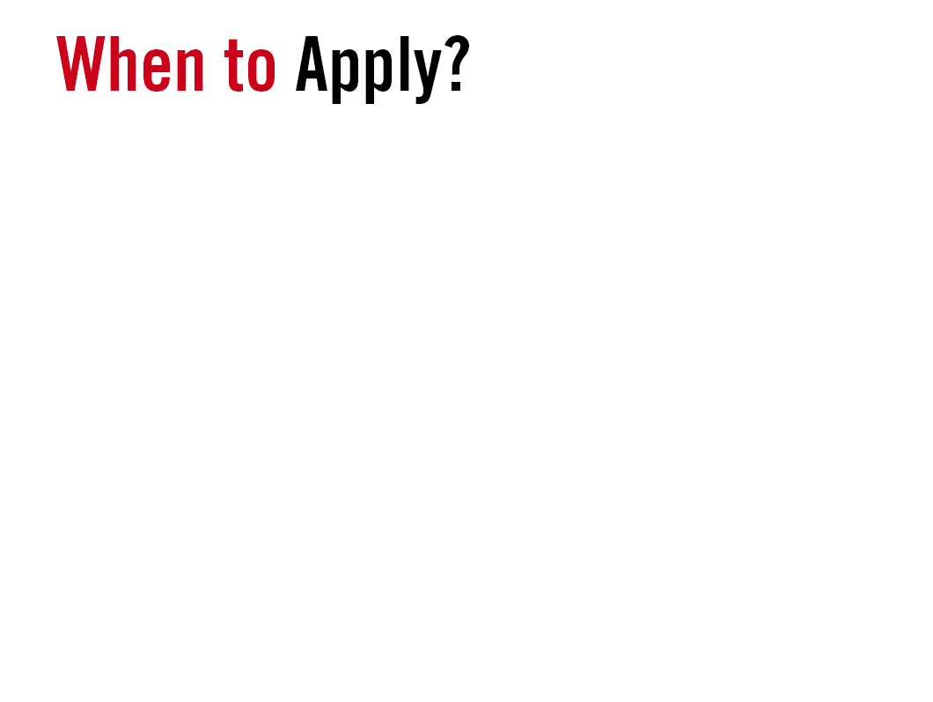
Rolling admissions for international applicants - Check the Calendar!
15 October 2014 - Online Application System Opens
Early April 2015 - Deadline for Graduate & PhD Applications
Early May 2015 - Deadline for Undergraduate Applications
Admissions depend on preferred interview date/location.
Applications must be submitted at least one month prior to the proposed interview session
Deadline for Dual Degrees
Each programme has its own deadline

Slide 12

2014-15 Annual Tuitions Fees (based on tax residence)
Undergraduate - up to €9,940
Graduate - up to €13,700
Financial Aid
Undergraduate - Boutmy (non-EU) and CROUS (EU) Scholarships
Graduate - Eiffel, Boutmy (non-EU) and CROUS (EU) Scholarships
Partnerships with Local Loan & Scholarship Authorities
Benefits for all Students in France
Monthly Housing Stipend (approx. €100)
Basic Healthcare Coverage upon Registration (€230)
Regular discounts
Books, Tech Equipment, Transportation, Museums, Cinemas, etc.

Slide 13

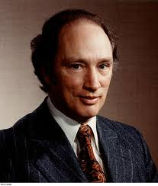

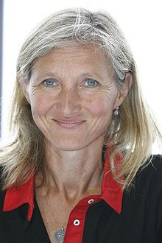

Pierre Trudeau – former Canadian Prime Minister
Boutros Boutros-Ghali – former UN Secretary General
Clara Gaymard – Vice President of GE International
YOU?

Slide 14
